Slide 1

CM20315 - Machine Learning
Prof. Simon Prince, Dr. Georgios Exarchakis and Dr. Andrew Barnes
1. Introduction
This is a VERY large lecture theatre. Please leave the back five rows empty!

Slide 2
CM20315 - Machine Learning
Prof. Simon Prince, Dr. Georgios Exarchakis and Dr. Andrew Barnes
1. Introduction

Slide 3


Slide 4
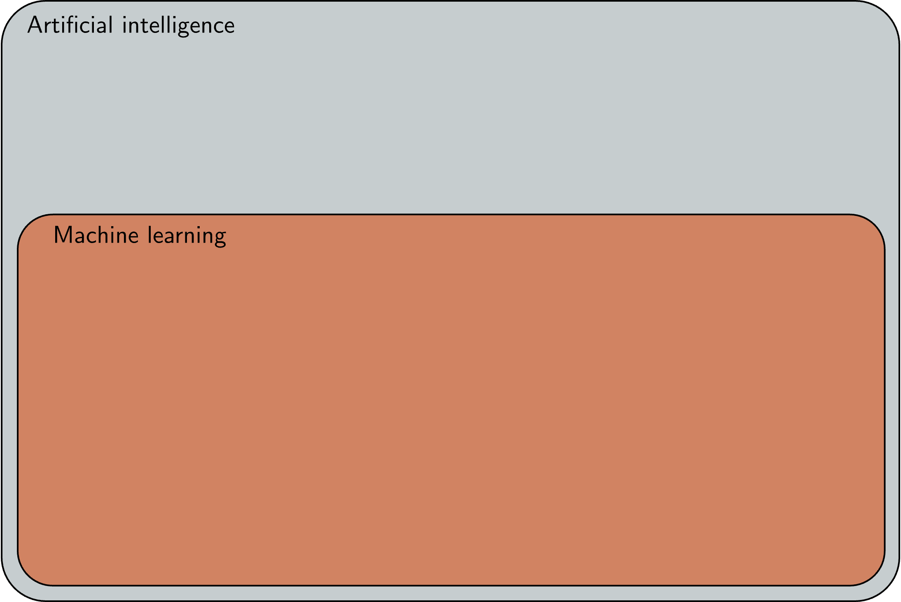

Slide 5
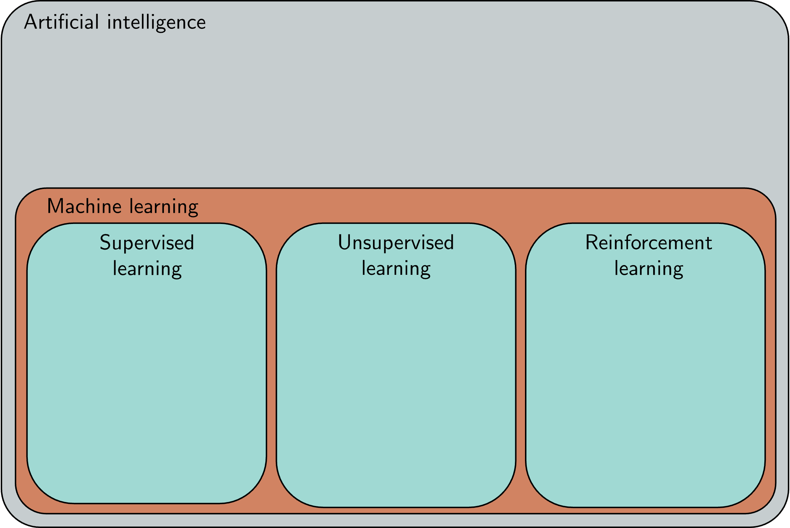

Slide 6
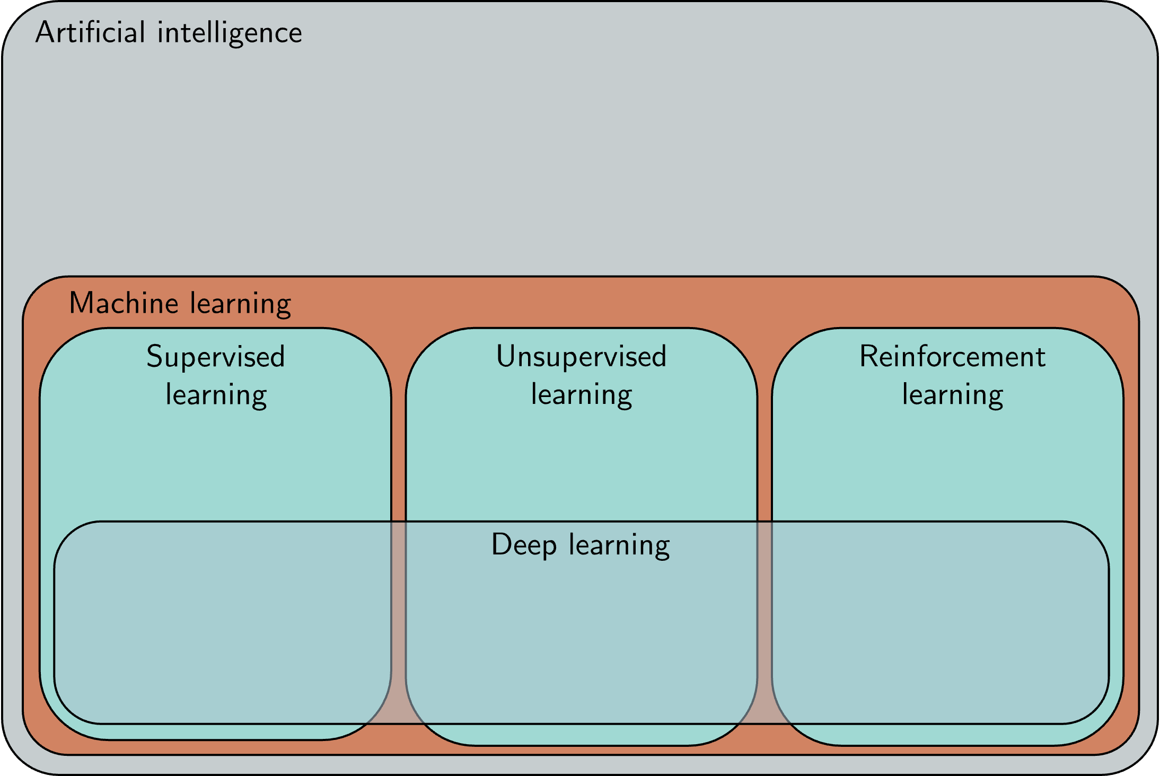

Slide 7
Semester 1

Slide 8
Logistics
Semester 1
2 lectures per week
1 lab session per week
5 weeks / consolidation week / 5 weeks
1 coursework
Set Monday 20th November
Due Monday 4th December
1 exam (Jan/Feb) – closed book
Lectures will be recorded

Slide 9
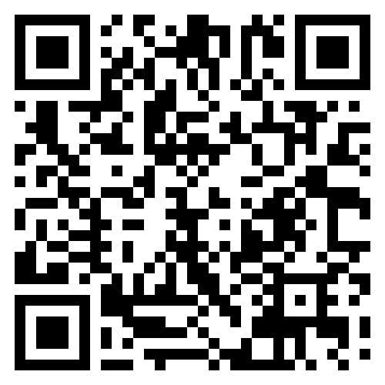
Feedback
Please ask questions in the lectures – put your hand up
There will be tutors to help in the labs and I will be present
Via to your class representatives.
You can ask questions on Moodle
Please answer other people’s questions if you can!
There is no such thing as a stupid question.
Anonymous feedback to me via:
https://forms.office.com/r/UjVD6Yzz01

Slide 10
Lab sessions
Python notebooks in CoLab
You will need a Google account (make one before tomorrow)
Alternatively, set up Jupyter Notebooks yourself (but don’t)
Numpy
Matplotlib
PyTorch
Problem sheets

Slide 11
How to pass this course
Ideas are simple, but build on one another
Come to the lectures
Come to the lab sessions
Complete the Python notebooks
Complete the problems
Work together on non-assessed work
Read the notes after the class
Mark everything on Moodle as completed
Ask questions on the Moodle forums

Slide 12
Book

Slide 13
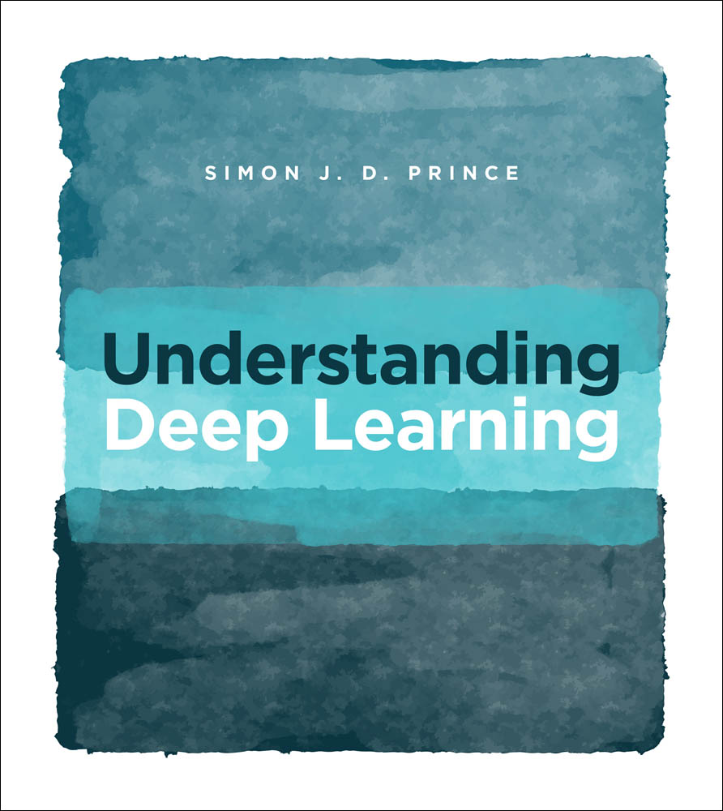
Book

Slide 14
Book
Published 5th December 2023

Slide 15
Book
http://udlbook.com

Slide 16
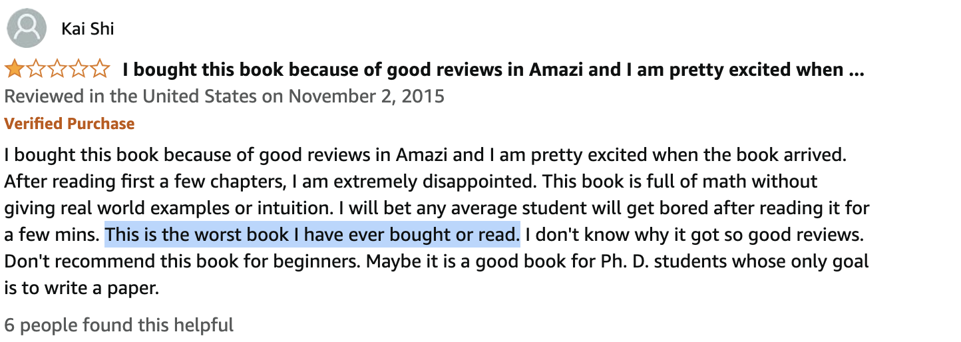

Slide 18
Book
Examinable unless specified
Chapters 1-10,12

Slide 19
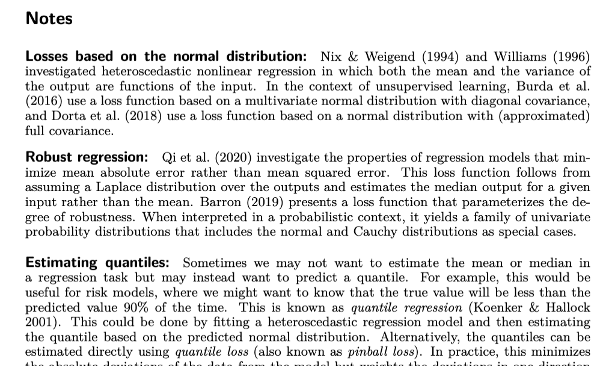
Book
Examinable unless specified
Chapters 1-10,12
Not examinable unless specified
Notes at end of chapters
Chap 15

Slide 21
Supervised learning
Define a mapping from input to output
Learn this mapping from paired input/output data examples

Slide 22
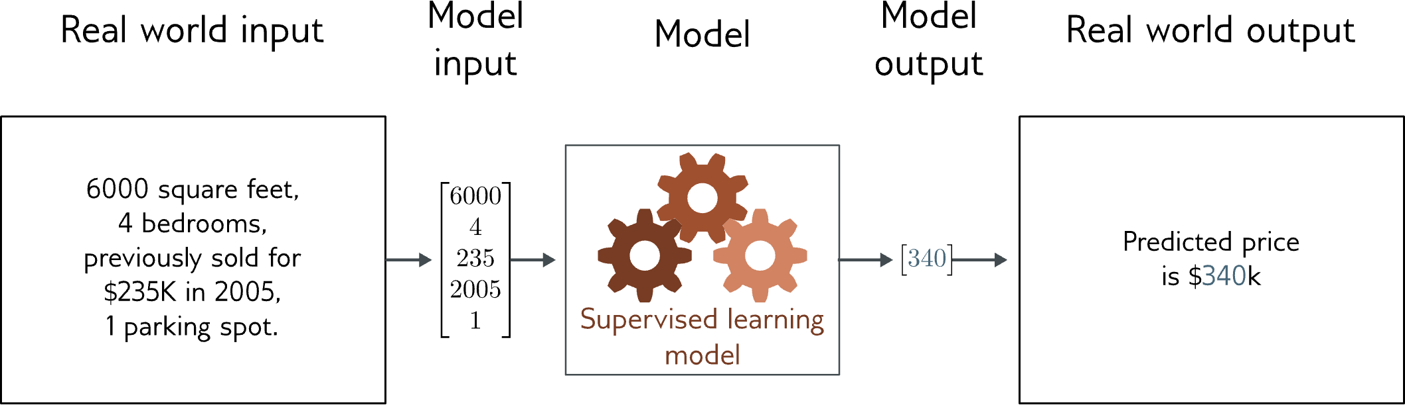
Regression
Univariate regression problem (one output, real value)
Fully connected network

Slide 23
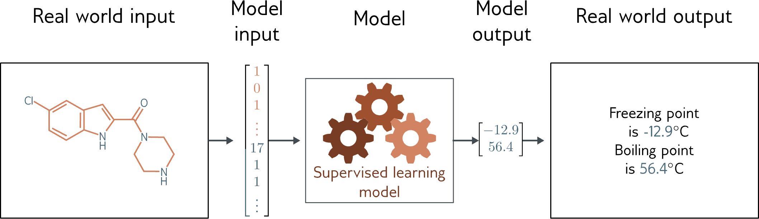
Graph regression
Multivariate regression problem (>1 output, real value)
Graph neural network

Slide 24
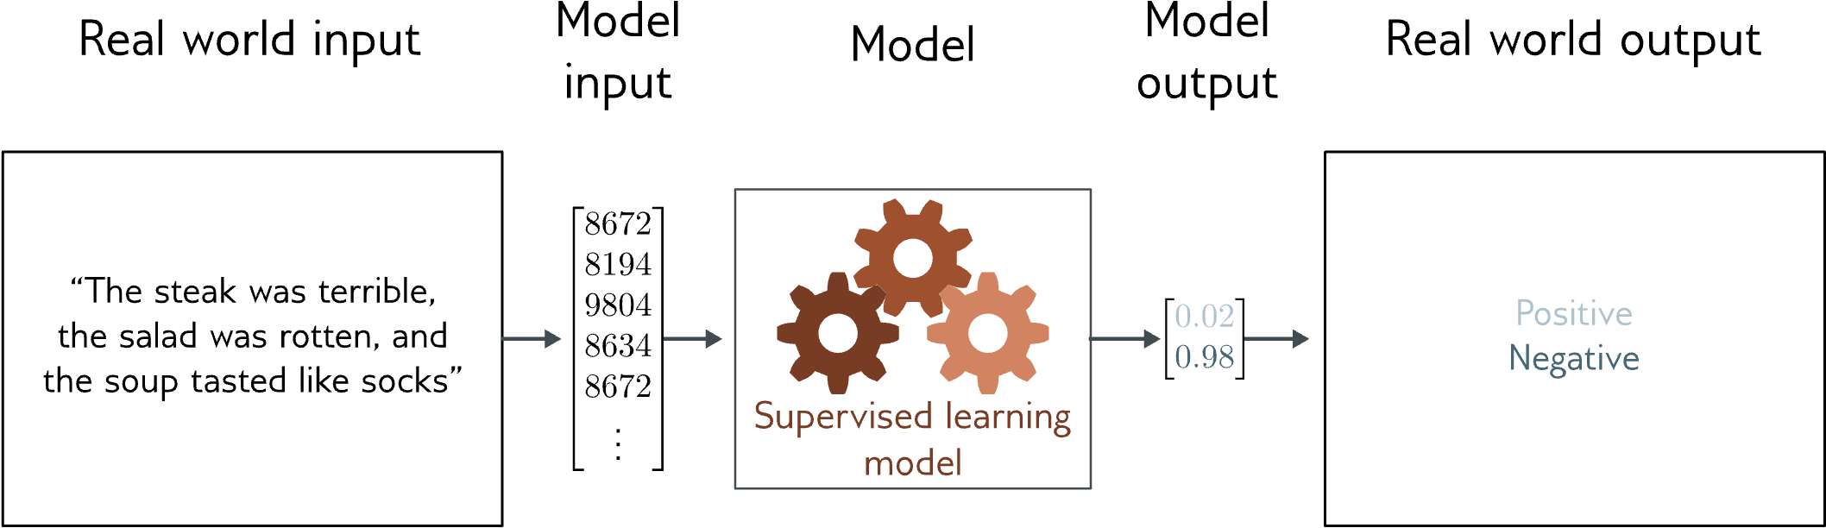
Text classification
Binary classification problem (two discrete classes)
Transformer network

Slide 25
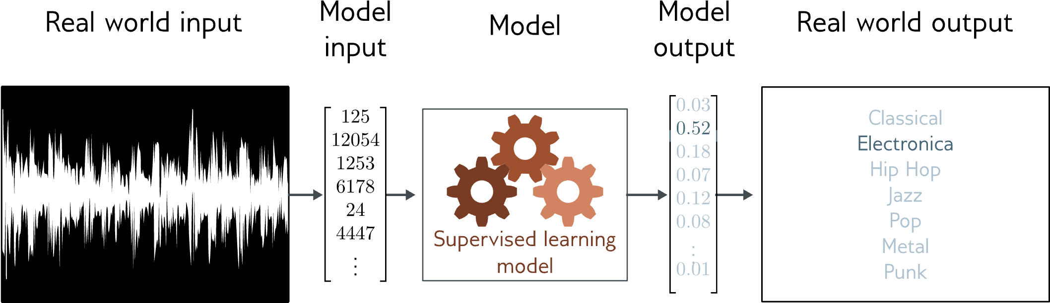
Music genre classification
Multiclass classification problem (discrete classes, >2 possible values)
Recurrent neural network (RNN)

Slide 26
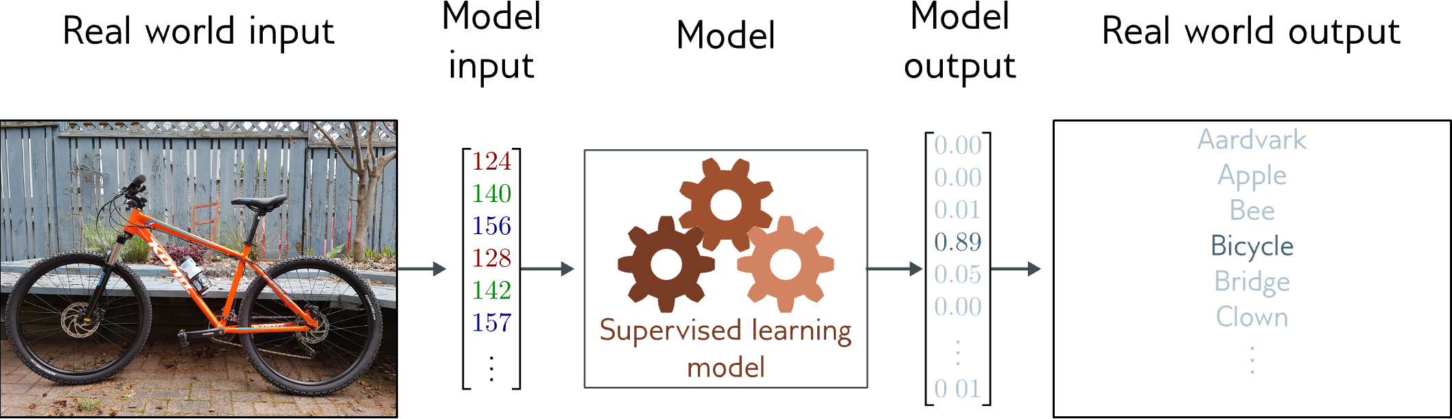
Image classification
Multiclass classification problem (discrete classes, >2 possible classes)
Convolutional network

Slide 27
What is a supervised learning model?
An equation relating input (age) to output (height)
Search through family of possible equations to find one that fits training data well

Slide 28
What is a supervised learning model?
Deep neural networks are just a very flexible family of equations
Fitting deep neural networks = “Deep Learning”

Slide 29
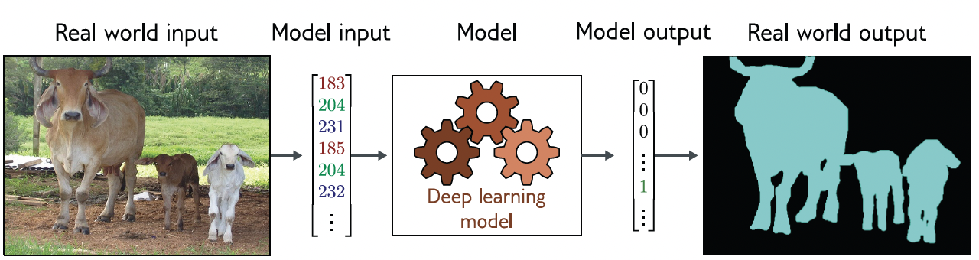
Image segmentation
Multivariate binary classification problem (many outputs, two discrete classes)
Convolutional encoder-decoder network

Slide 30
Depth estimation
Multivariate regression problem (many outputs, continuous)
Convolutional encoder-decoder network

Slide 31
Pose estimation
Multivariate regression problem (many outputs, continuous)
Convolutional encoder-decoder network

Slide 32
Terms
Regression = continuous numbers as output
Classification = discrete classes as output
Two class and multiclass classification treated differently
Univariate = one output
Multivariate = more than one output

Slide 33
Translation

Slide 34
Image captioning

Slide 35
Image generation from text

Slide 36
What do these examples have in common?
Very complex relationship between input and output
Sometimes may be many possible valid answers
But outputs (and sometimes inputs) obey rules
Language obeys grammatical rules
Natural images also have “rules”

Slide 37
Idea
Learn the “grammar” of the data from unlabeled examples
Can use a gargantuan amount of data to do this (as unlabeled)
Make the supervised learning task earlier by having a lot of knowledge of possible outputs

Slide 39
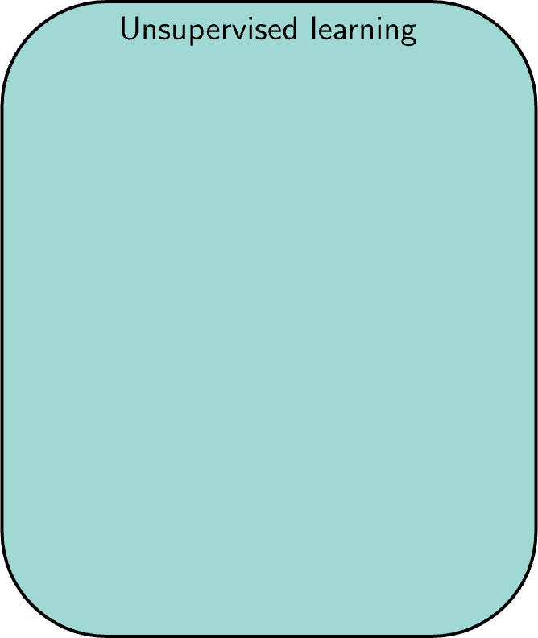
Unsupervised Learning
Learning about a dataset without labels
Clustering
Finding outliers
Generating new examples
Filling in missing data

Slide 40

DeepCluster: Deep Clustering for Unsupervised Learning of Visual Features (Caron et al., 2018)

Slide 41
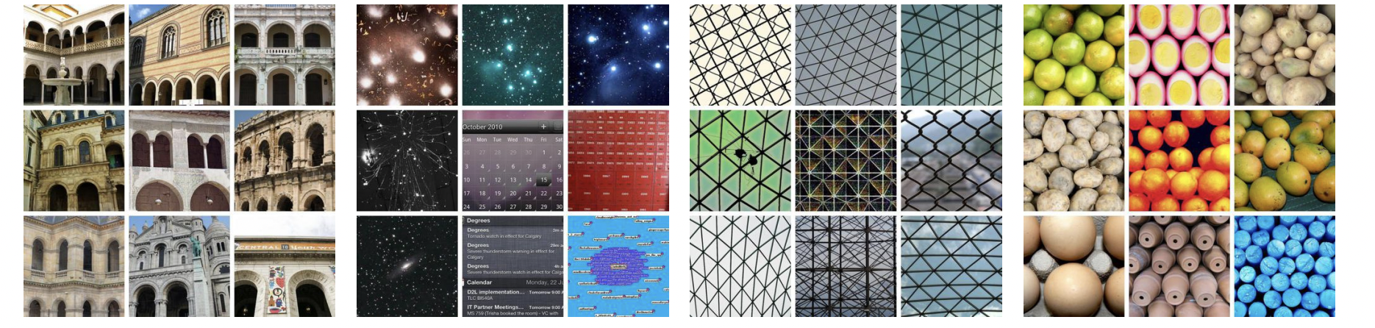
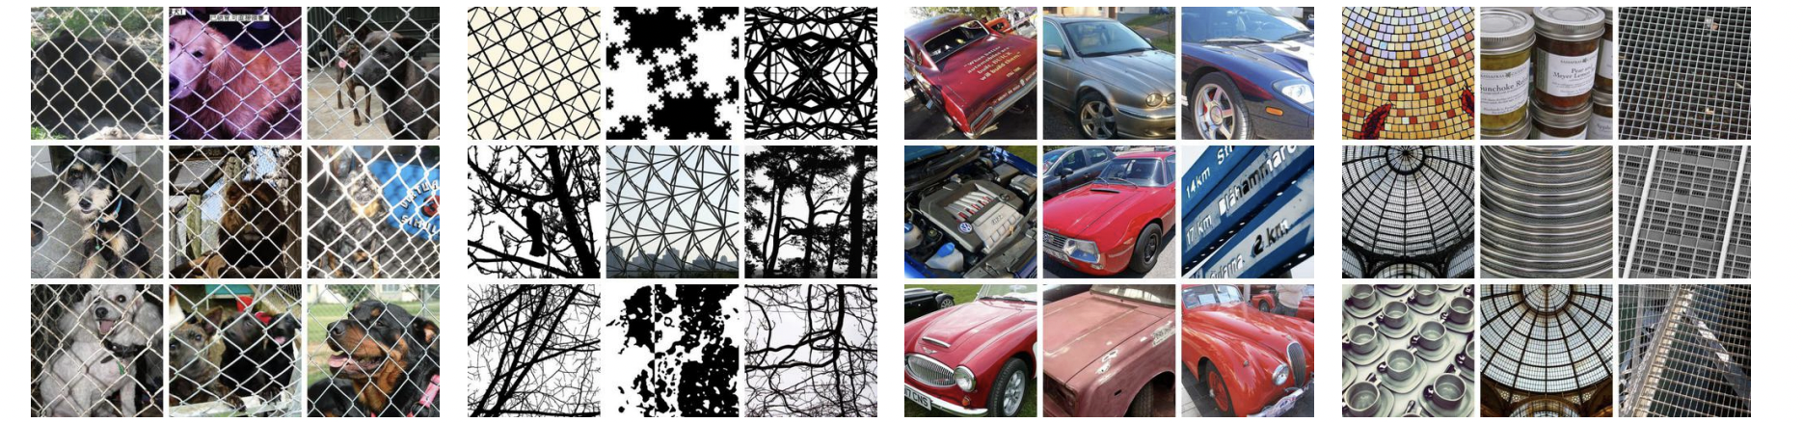
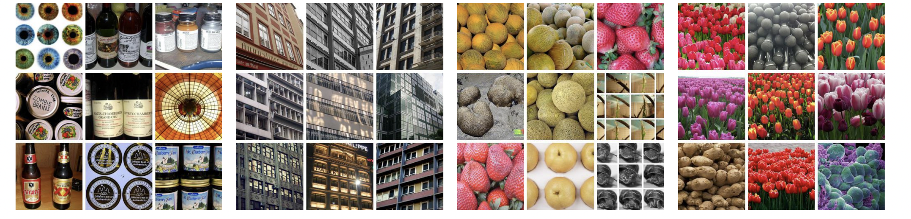
DeepCluster: Deep Clustering for Unsupervised Learning of Visual Features (Caron et al., 2018)

Slide 42
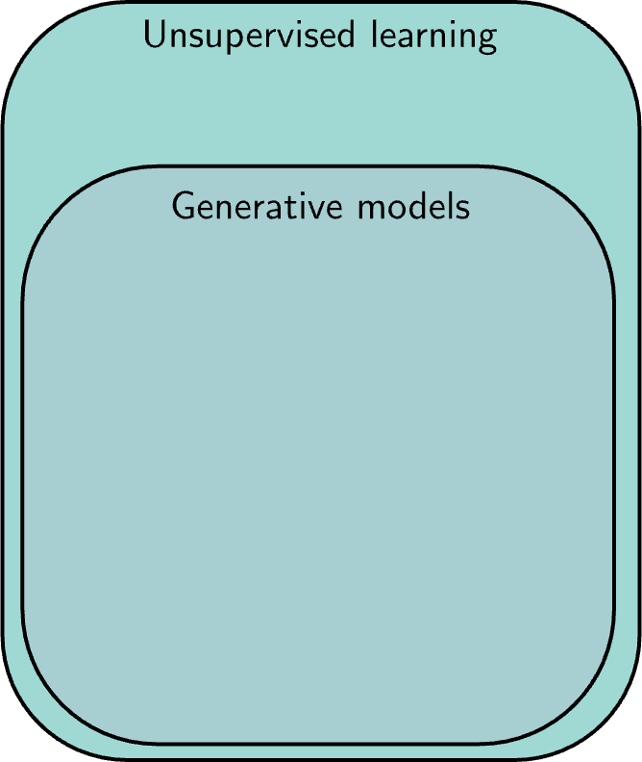
Unsupervised Learning
Learning about a dataset without labels
e.g., clustering
Generative models can create examples
e.g., generative adversarial networks

Slide 43
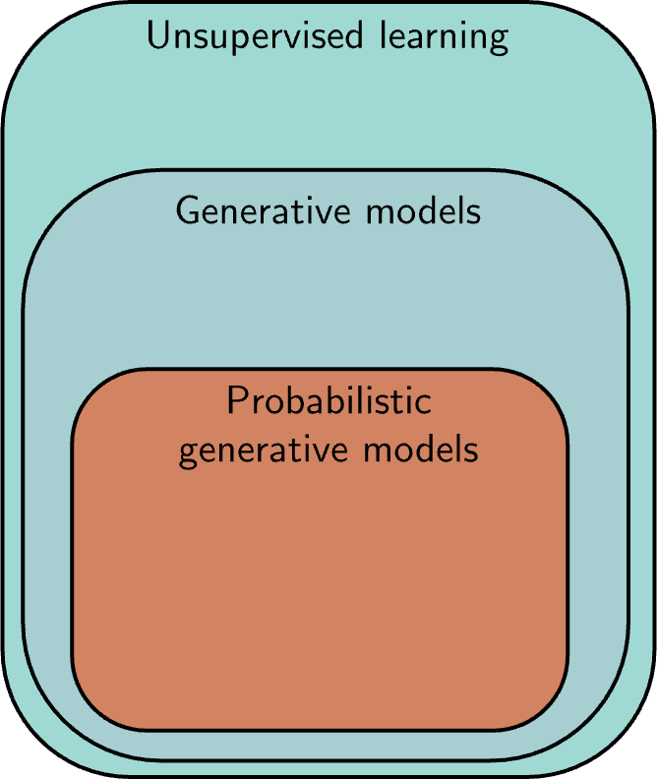
Unsupervised Learning
Learning about a dataset without labels
e.g., clustering
Generative models can create examples
e.g., generative adversarial networks
PGMs learn distribution over data
e.g., variational autoencoders,
e.g., normalizing flows,
e.g., diffusion models

Slide 44
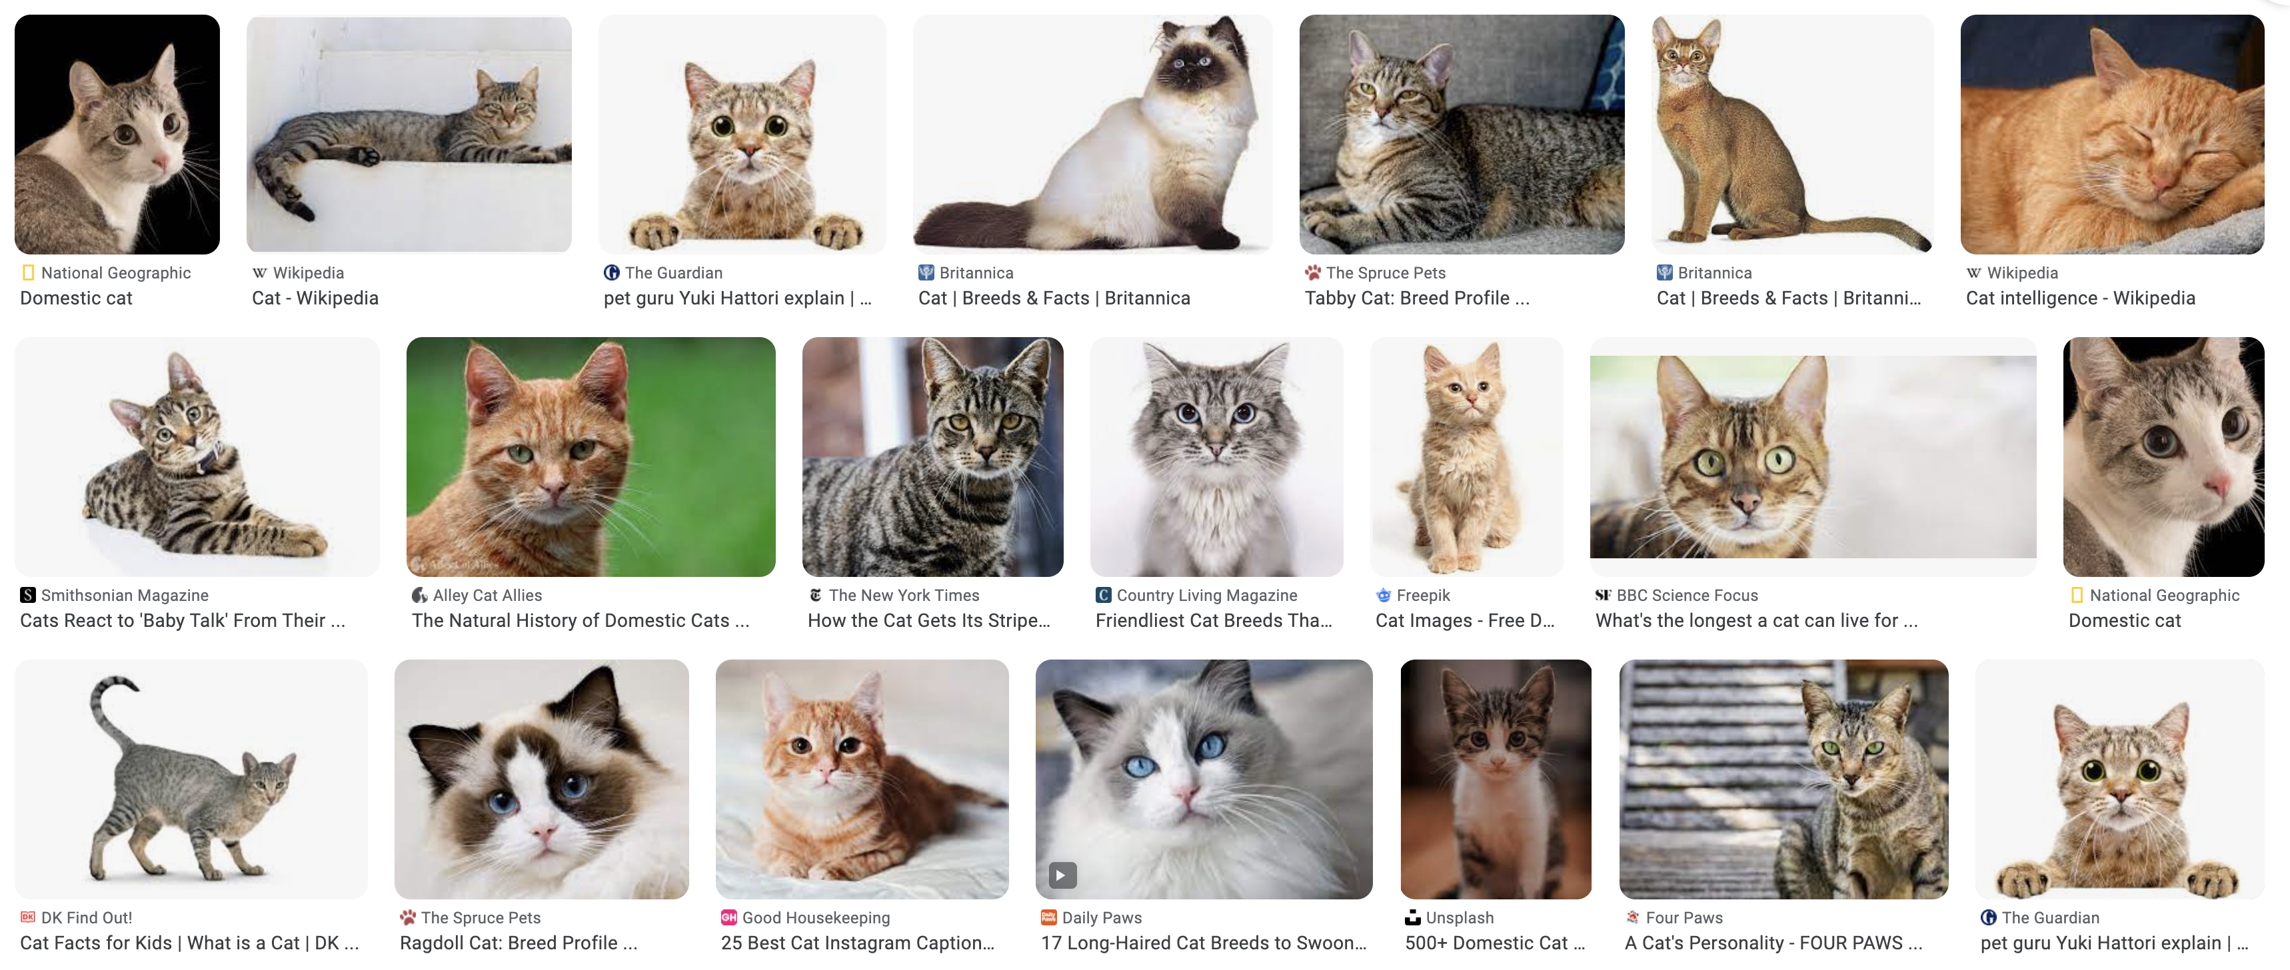
Generative models

Slide 45
Generative models

Slide 46
Latent variables

Slide 47
Why should this work?

Slide 48
Interpolation

Slide 49
Conditional synthesis

Slide 50
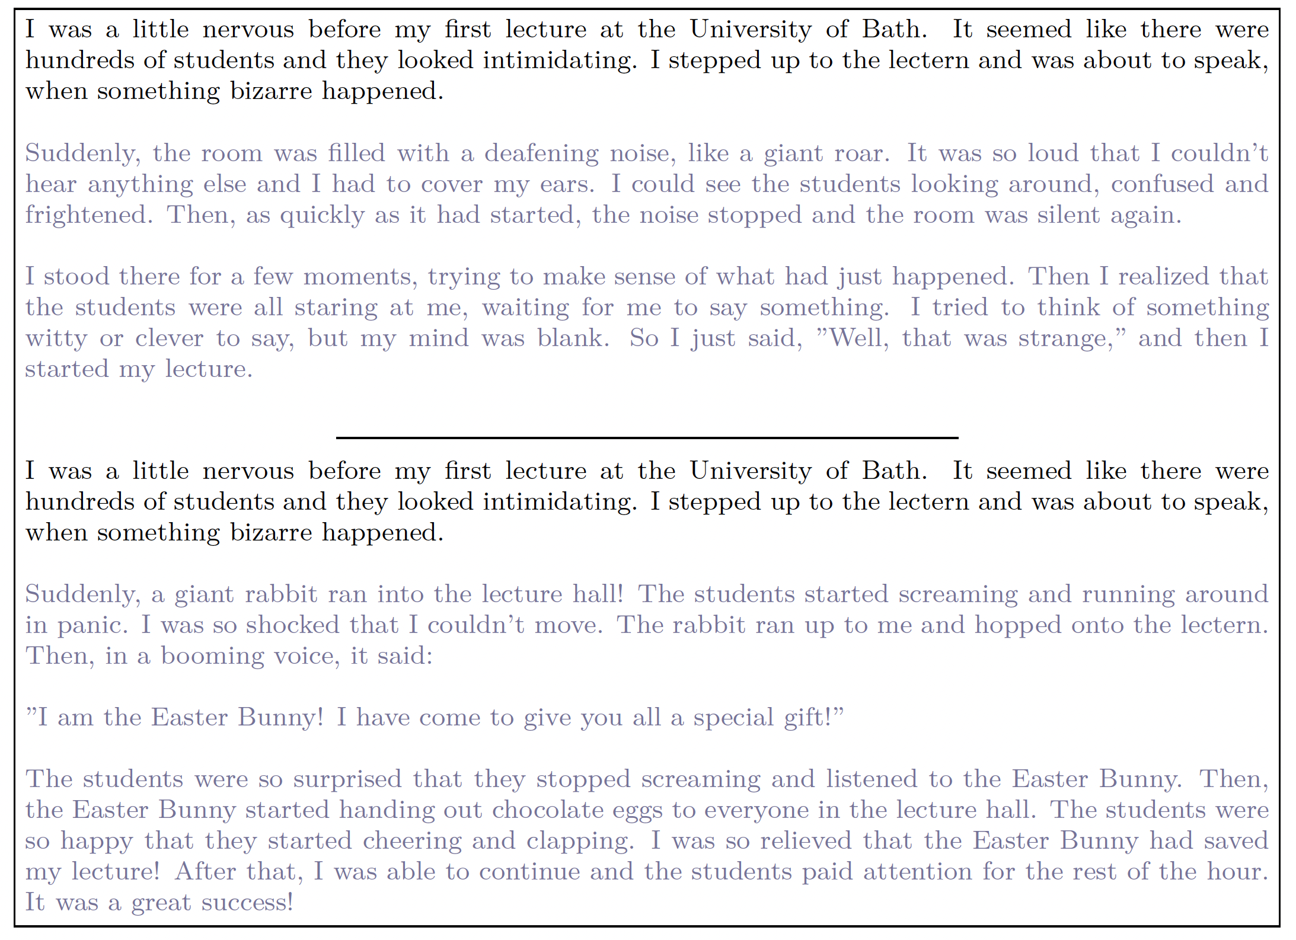

Slide 52
Reinforcement learning
A set of states
A set of actions
A set of rewards
Goal: take actions to change the state so that you receive rewards
You don’t receive any data – you have to explore the environment yourself to gather data as you go

Slide 53
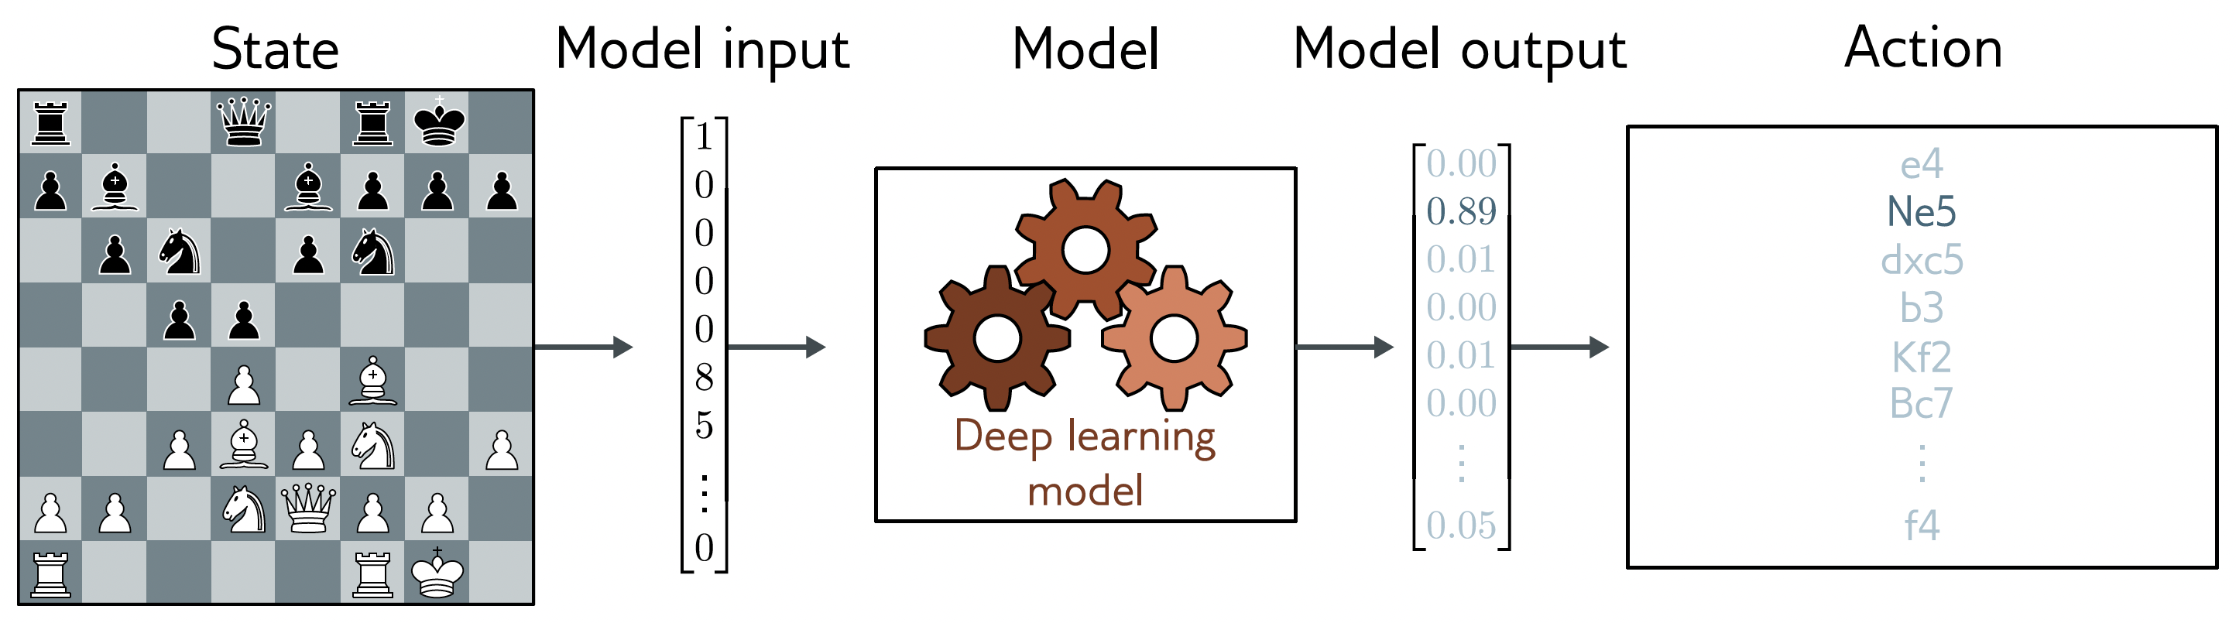
Example: chess
States are valid states of the chess board
Actions at a given time are valid possible moves
Positive rewards for taking pieces, negative rewards for losing them

Slide 54
Example: chess
States are valid states of the chess board
Actions at a given time are valid possible moves
Positive rewards for taking pieces, negative rewards for losing them

Slide 55
Why is this difficult?
Stochastic
Make the same move twice, the opponent might not do the same thing
Rewards also stochastic (opponent does or doesn’t take your piece)
Temporal credit assignment problem
Did we get the reward because of this move? Or because we made good tactical decisions somewhere in the past?
Exploration-exploitation trade-off
If we found a good opening, should we use this?
Or should we try other things, hoping for something better?

Slide 56
Landmarks in Deep Learning
1958 Perceptron (Simple `neural’ model)
1986 Backpropagation (Practical Deep Neural networks)
1989 Convolutional networks (Supervised learning)
2012 AlexNet Image classification (Supervised learning)
2014 Generative adversarial networks (Unsupervised learning)
2014 Deep Q-Learning -- Atari games (Reinforcement learning)
2016 AlphaGo (Reinforcement learning)
2017 Machine translation (Supervised learning)
2019 Language models ((Un)supervised learning)
2022 Dall-E2 Image synthesis from text prompts ((Un)supervised learning)
2022 ChatGPT ((Un)supervised learning)
2023 GPT4 Multimodal model ((Un)supervised learning)

Slide 57
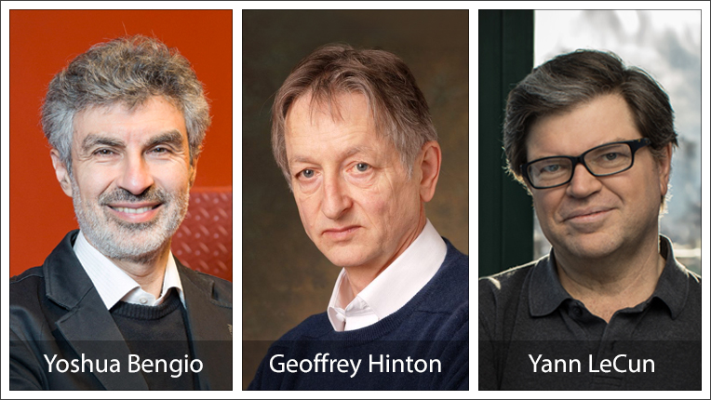
2018 Turing award winners

Slide 58
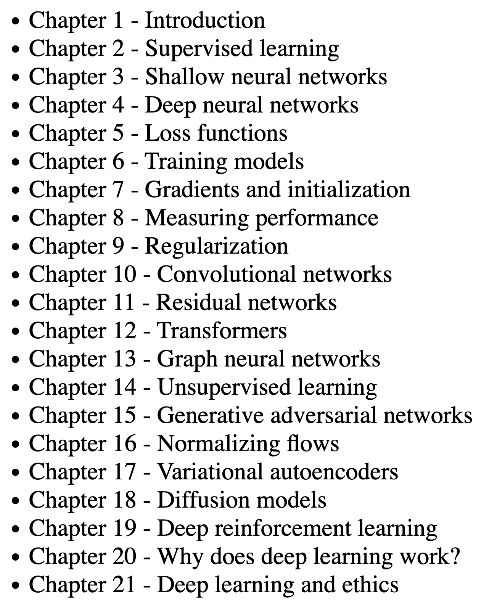
This course
Deep neural networks
How to train them
How to measure their performance
How to make that performance better

Slide 59
This course
Networks specialized to images
Image classification
Image segmentation
Pose estimation

Slide 60
This course
Networks specialized to text
Text generation
Automatic translation
ChatGPT

Slide 61
This course
Generative learning (unsupervised)
Generating random cats!

Slide 62
MAKE A GOOGLE/GMAIL ACCOUNT!
Feedback

